Slide 1

A+ Guide to Managing and Maintaining your PC, 6e
Chapter 1
Introducing Hardware

Slide 2
Objectives
Learn that a computer requires both hardware and software to work
Learn about the many different hardware components inside of and connected to a computer

Slide 3
Introduction
End users need not know how a computer works
To add to your end user knowledge, study is needed
Studying this text will help you do the following:
Install new hardware and software
Diagnose hardware and software problems
Solve hardware and software problems
Evaluate new hardware and operating systems
Pass the A+ series of exams

Slide 4
Hardware Needs Software to Work
Hardware: physical portion of a computer
Components: monitor, keyboard, memory, hard drive
Software: instructions used to manipulate hardware
Requirements: input, processing, storage, output
All hardware operations are based on binary values
Binary number system consists of two digits: 0 and 1
Fundamental groupings of binary numbers:
Bit: binary digit that can take on values of 0 or 1
Nibble: four bits
Byte: four bits

Slide 5
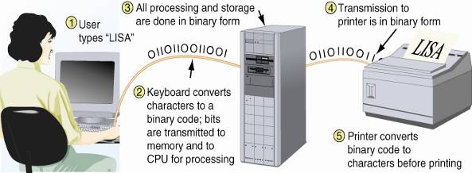
Figure 1-2 All communication, storage, and processing of data inside a computer are in binary form until presented as output to the user

Slide 6
PC Hardware Components
Most input/output (I/O) devices are external to case
Most processing and storage devices are internal
Central processing unit (CPU)
Also called the processor or microprocessor
Reads input, processes data, writes data to storage
Elements required by I/O and storage devices
A method for CPU to communicate with the device
Software to instruct and control the device
Electricity to power the device

Slide 7
Hardware Used for Input and Output
Connections to the case can be cabled or wireless
Port: access point located in back or front of case
Chief input devices:
Keyboard: enhanced type holds 104 keys
Mouse: pointing device used to select screen items
Chief output devices:
Monitor: visually displays primary output of computer
Printer: produces output on paper (hard copy)

Slide 8
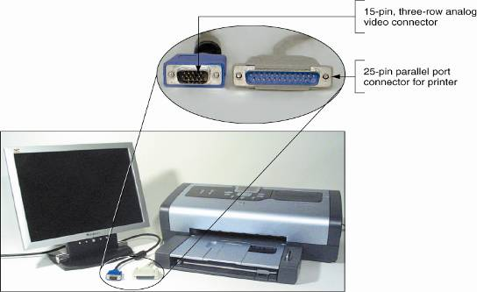
Figure 1-6 The two most popular output devices are the monitor and the printer

Slide 9
Hardware Inside the Computer Case
Most storage and processing occurs in the case
Internal devices common to most computers:
Motherboard containing CPU, memory, other parts
Floppy drive, hard drive, CD drive for persistent storage
Power supply with power cords supplying electricity
Circuit boards for internal and external communication
Cables to connect devices to all circuit boards
Expansion cards are installed in expansion slots
Two types of cables: data (communication) and power

Slide 10
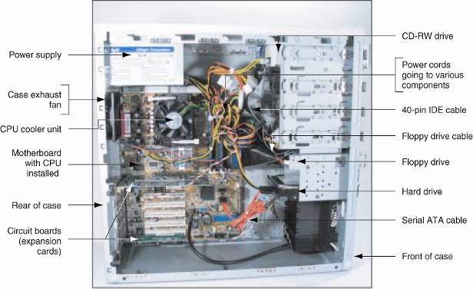
Figure 1-8 Inside the computer case

Slide 11
The Motherboard
The largest and most important circuit board
Also known as the main board or system board
Contains the CPU, expansion slots, other devices
Categories used to group motherboard components
Processing, temporary storage, communication, power
All devices communicate with CPU on motherboard
A peripheral device links to motherboard via cable
Some motherboard ports outside of the case:
Keyboard, mouse, parallel, USB ports, sound ports

Slide 12
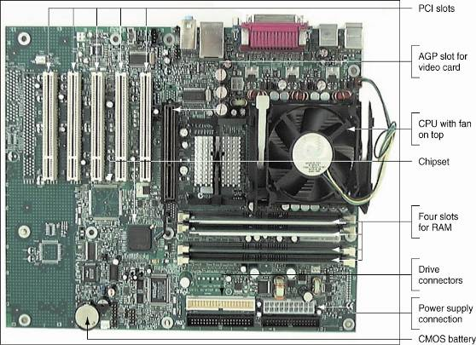
Figure 1-9 All hardware components are either located on the motherboard or directly or indirectly connected to it because they must all communicate with the CPU

Slide 13
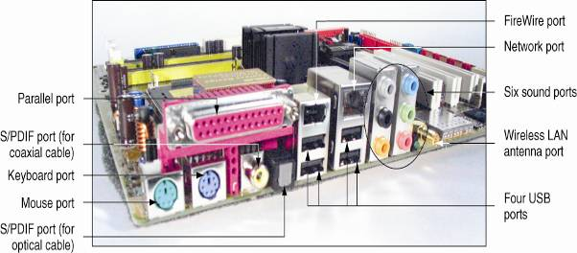
Figure 1-10 A motherboard provides ports for common I/O devices

Slide 14
The Processor and the Chipset
CPU: chip that performs most data processing
Chipset: group of microchips controlling data flow
Personal computer (PC): chief focus of this text
Major manufacturers of CPUs and chipsets for PCs
Intel Corporation, AMD, VIA, SiS, and Cyrix

Slide 15
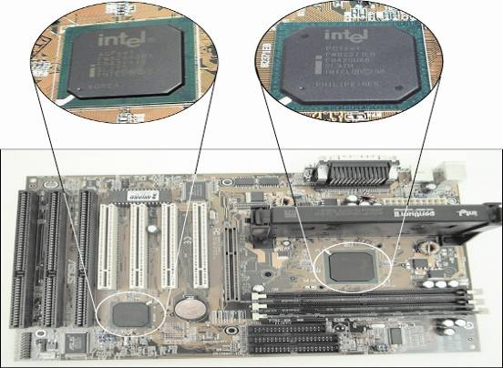
Figure 1-12 This motherboard uses two chips in its chipset (notice the bus lines coming from each chip
used for communication)

Slide 16
Storage Devices
Primary storage (main memory):
Temporary storage used by the processor
Example: RAM (random access memory)
Secondary storage (permanent storage):
Enables data to persist after the machine is turned off
Examples: hard drive, CD, floppy disk
Analogy to primary-secondary memory relationship
Book stacks in a library are like permanent storage
Books can be moved to a desk (temporary storage)

Slide 17
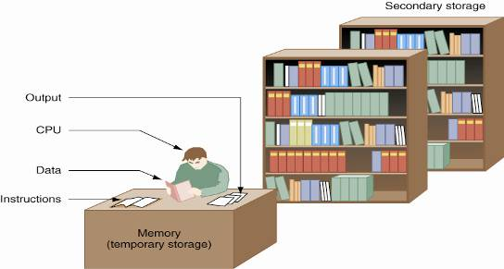
Figure 1-13 Memory is a temporary place to hold instructions and data while the CPU processes both

Slide 18
Primary Storage
RAM (random access memory):
Device providing temporary storage
Located on motherboard and on other circuit boards
Three types of RAM boards (memory modules):
DIMM (dual inline memory module)
RIMM (Rambus inline memory module)
SIMM (single inline memory module)
RAM is volatile (data does not persist)
ROM (read-only memory) is nonvolatile

Slide 19
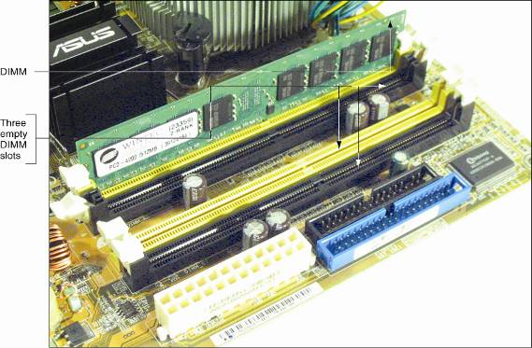
Figure 1-14 A SIMM, DIMM, or RIMM holds RAM and is mounted directly on a motherboard

Slide 20
Secondary Storage
Hard drive
Case containing disks that rotate at high speeds
An arm with a read/write head traverses the platter
Integrated Drive Electronics (IDE)
Technology used internally by a hard drive
ATA (AT Attachment) standard
Specifies motherboard-hard drive interface
Types: Serial ATA or parallel ATA (Enhanced IDE)
Parallel ATA accommodates up to four IDE devices

Slide 21
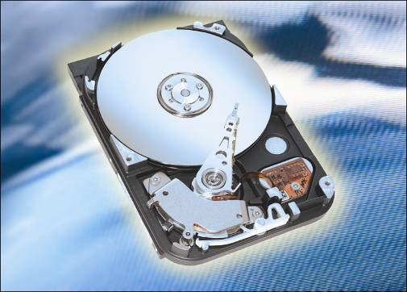
Figure 1-16 Hard drive with sealed cover removed

Slide 22
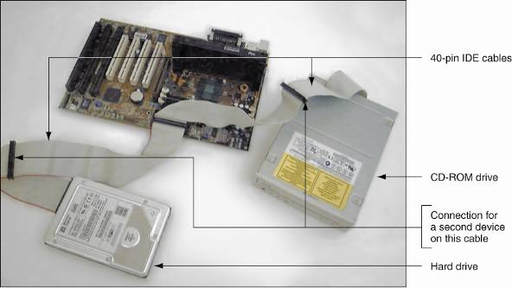
Figure 1-18 Two IDE devices connected to a motherboard using both IDE connections and two cables

Slide 23
Secondary Storage (continued)
Serial ATA standard
Allows for more than four drives in a system
Applies only to hard drives and not to other drives
Some IDE devices: hard drives, Zip drives, CD drive
Floppy drive
3.5-inch disk holding 1.44 MB of data
Floppy drive connector is distinct from IDE connectors
CD-ROM (compact disc read-only memory) drive
Standard equipment for reading software distributions

Slide 24
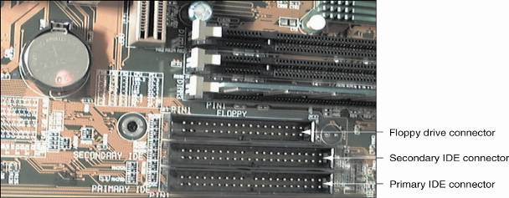
Figure 1-22 A motherboard usually provides a connection for a floppy drive cable

Slide 25
Motherboard Components Used For Communication Among Devices
Traces: circuits or paths that move data and power
Bus: system of pathways and transmission protocols
Data bus
Lines in a bus that carry the data
Binary bits correspond to voltage values of on or off
Data path sizes: 8, 16, 32, 64, or 128 bits wide
Main bus on motherboard (system bus, memory bus)
Communicates with CPU, memory, and chipset
Pulse of system clock carried by line on motherboard

Slide 26
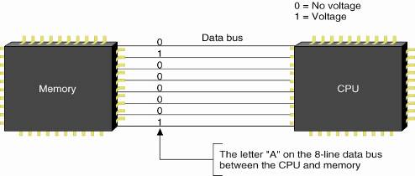
Figure 1-26 A data bus has traces or lines that carry voltage interpreted by the CPU and other devices as bits

Slide 27
Motherboard Components Used For Communication Among Devices (continued)
Devices work according to beats (or cycles)
Clock speed is measured in hertz (cycles/second)
One megahertz (MHz): one million cycles per second
One gigahertz (GHz): one billion cycles per second
Common ratings for motherboard buses
1066 MHz, 800 MHz, 533 MHz, or 400 MHz
Range of CPU speeds: 166 MHz to 4 GHz
Buses for expansion slots: PCI, AGP, ISA

Slide 28
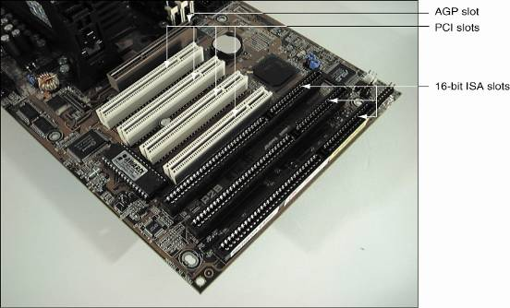
Figure 1-29 PCI bus expansion slots are shorter than ISA slots and offset farther; the one AGP slot is set farther from the edge of the board

Slide 29
Interface (Expansion) Cards
Some names for circuits mounted in expansion slots:
Circuit cards, adapter boards, expansion cards, cards
Cards that connect the CPU to an external device:
Video: provides a port for the monitor
Sound: provides ports for speakers and microphones
Network: provides a port for a network cable
Modem: provides ports for phone lines
Determine a card’s function by identifying its port

Slide 30
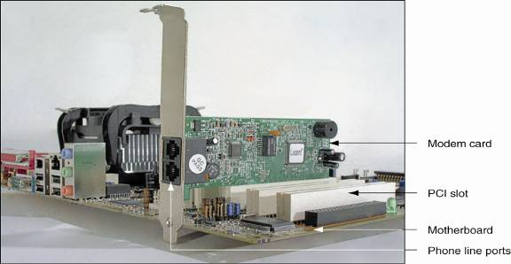
Figure 1-31 This circuit board is a modem card and is mounted in a PCI slot on the motherboard

Slide 31
The Electrical System
Power supply
Most important electrical component
Converts AC voltage external source to DC voltage
Reduces voltage from 110-120 volts to 12 volts or less
Runs a fan to cool the inside of the computer case
Temperatures > 185° F can cause component failure
Motherboard has 1 or 2 connections to power supply

Slide 32
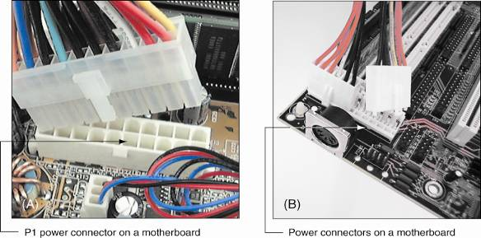
Figure 1-35 The motherboard receives its power from the power supply by way of one or more connections located near the edge of the board or near the processor

Slide 33
Instructions Stored on the Motherboard and Other Boards
BIOS (basic input/output system)
Data and instructions stored on ROM chips
ROM BIOS chips are a type of firmware
Three purposes served by motherboard ROM BIOS:
System BIOS: used to manage simple devices
Startup BIOS: used to start the computer
CMOS setup: used to change motherboard settings
CMOS RAM: includes date, time, port configurations
Flash ROM: ROM chips the can be overwritten

Slide 34
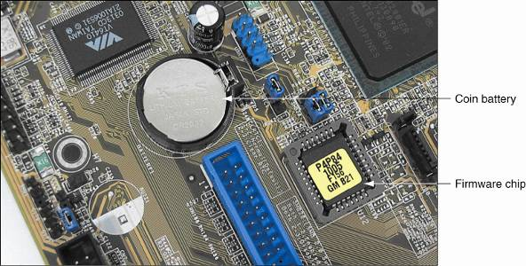
Figure 1-36 This firmware chip contains flash ROM and CMOS RAM; CMOS RAM is powered by the coin battery located near the chip

Slide 35
Advanced Configuration and Power Interface
Also known as ACPI
Standards specifying a power saving feature
Enables a system to power up by a keyboard
Supported by most systems, such as Windows XP
Advanced Power Management (APM)
Older BIOS power management standard

Slide 36
Plug and Play
Also known as PnP
Standard simplifying installation of hardware devices
PnP BIOS begins process of configuring devices
PnP-compliant operating system completes configuration
ESCD (extended system configuration data) Plug and Play BIOS
Enhanced version of PnP
Stores manual configuration steps

Slide 37
Summary
A computer comprises hardware and software
Main functions: input, output, processing, storage
Data is stored in a binary format (1 or 0, on or off)
Input/output devices: keyboard, mouse, printer, monitor
Motherboard (system board): contains the CPU, access to other circuit boards and peripherals

Slide 38
Summary (continued)
Primary storage (RAM) is volatile (temporary)
Secondary storage is nonvolatile (permanent)
Parallel and serial ATA standards: enable secondary storage devices to interface with the motherboard
Computer bus: system of communication pathways and protocols
ROM BIOS helps start PCs, manage simple devices, and change some motherboard settings

